Slide 1
LOVE ACROSS THE DECADES
As represented through popular music
Blue Team 2
Supreet Deshpande, Emmanuel Kinuthia, Katlyn Limer, Lahari Revuri, & Travis Walker

Slide 2
THE DEGRADATION OF LOVE
1965
"Sunshine on a cloudy day" The Temptations
"Hey, what's up, hello" Fetty Wap
2015

Slide 3
AGENDA
1960
1980
2000
RELATIONSHIP FOCUS
DANCE / PARTYING
1970
1990

Slide 4





TOP WORDS IN EACH DECADE
1960:
1970:
1980:
1990:
2000:
Baby
Sweet
Heart
Girl
Good
Baby
Sweet
Hot
Funk
Boogie
Baby
Like
Heart
Give
Beat
Baby
Promise
Feel
Dance
[insert profanity here]
Baby
Girl
Boom
Shake
[insert more profanity here]
‘60s Top Words
’70s Top Words
‘80s Top Words
‘90s Top Words
‘00s Top Words
Conclusion

Slide 5
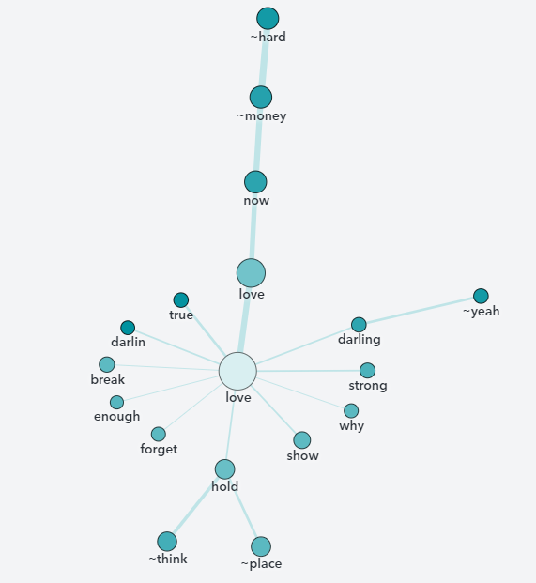

1960 TOP WORDS
1960:
Baby
Sweet
Heart
Girl
Good
‘60s Top Words
’70s Top Words
‘80s Top Words
‘90s Top Words
‘00s Top Words
Conclusion

Slide 6
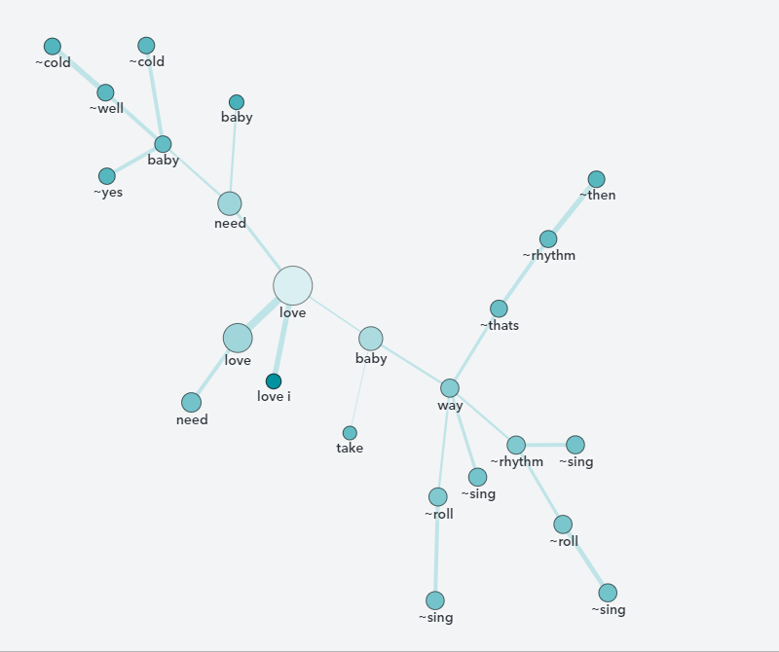
1970 TOP WORDS
1970:
Baby
Sweet
Hot
Funk
Boogie
‘60s Top Words
’70s Top Words
‘80s Top Words
‘90s Top Words
‘00s Top Words
Conclusion

Slide 7
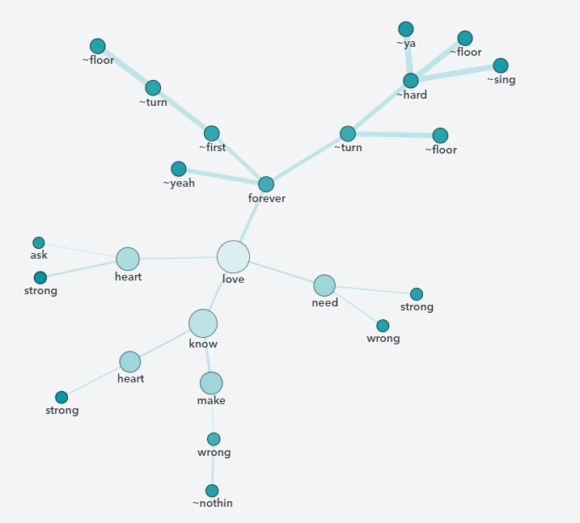

1980 TOP WORDS
1980:
Baby
Like
Heart
Give
Beat
‘60s Top Words
’70s Top Words
‘80s Top Words
‘90s Top Words
‘00s Top Words
Conclusion

Slide 8
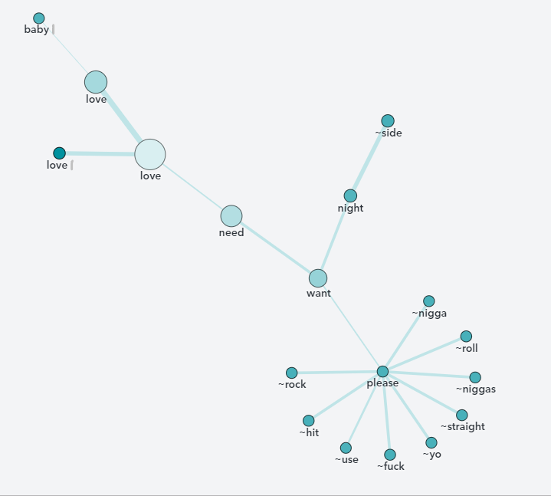


1990 TOP WORDS
1990:
Baby
Promise
Feel
Dance
[Curse Word ]
‘60s Top Words
’70s Top Words
‘80s Top Words
‘90s Top Words
‘00s Top Words
Conclusion

Slide 9
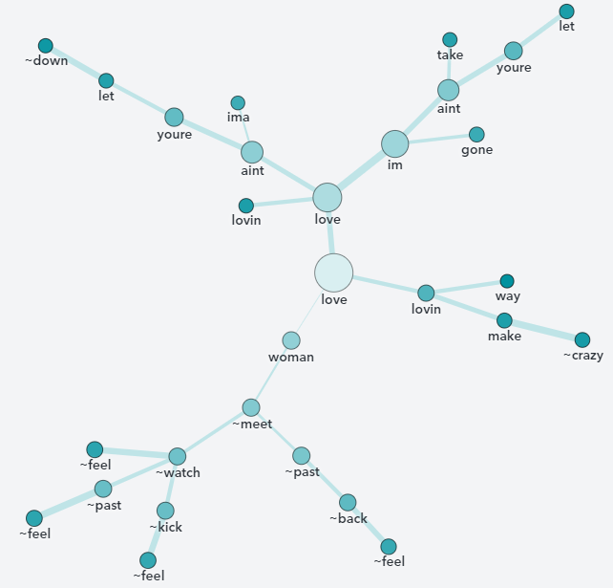
2000 TOP WORDS
2000:
Baby
Girl
Boom
Shake
[Curse Word]
‘60s Top Words
’70s Top Words
‘80s Top Words
‘90s Top Words
‘00s Top Words
Conclusion

Slide 10
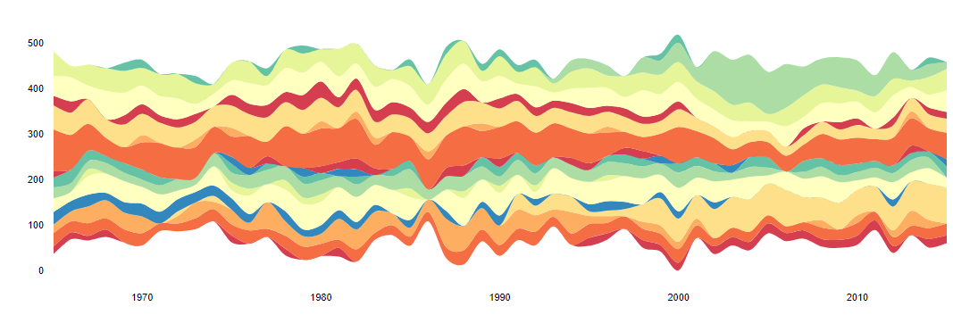
Frequency of Popular Themes
Year
‘60s Top Words
’70s Top Words
‘80s Top Words
‘90s Top Words
‘00s Top Words
Conclusion

Slide 11
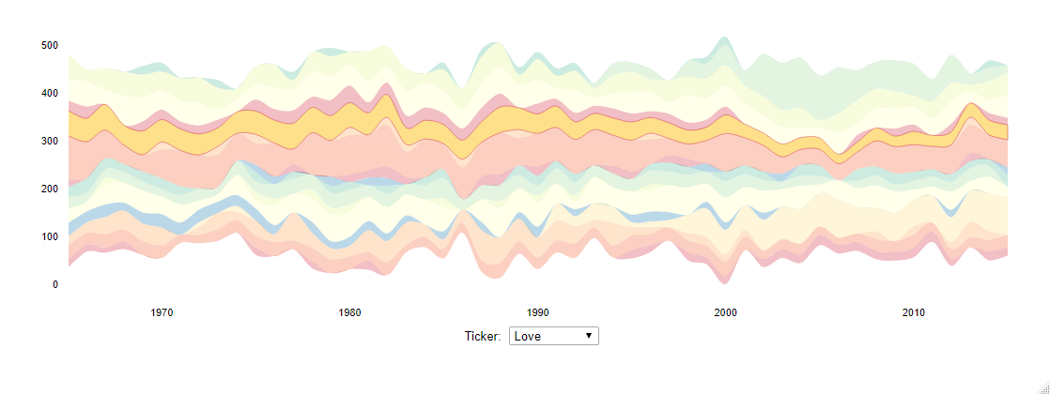
\
Frequency of Popular Themes
Year
Love
‘60s Top Words
’70s Top Words
‘80s Top Words
‘90s Top Words
‘00s Top Words
Conclusion

Slide 12
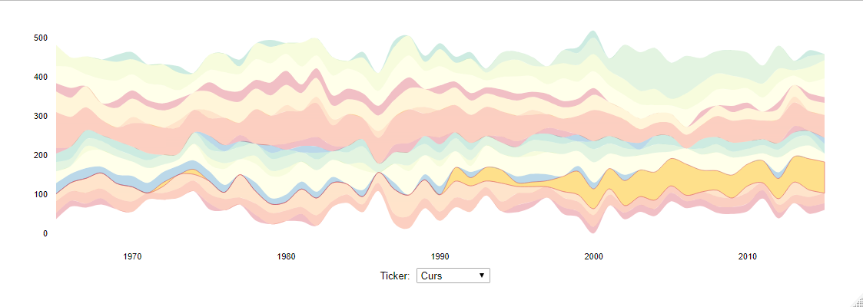
Frequency of Popular Themes
Year
Profanity
‘60s Top Words
’70s Top Words
‘80s Top Words
‘90s Top Words
‘00s Top Words
Conclusion

Slide 13
Frequency of Popular Themes
Year
1997
‘60s Top Words
’70s Top Words
‘80s Top Words
‘90s Top Words
‘00s Top Words
Conclusion

Slide 14
CONCLUSION
Love and partying were main themes across the decades
Decent lyrics depicting love in the '60s to ‘80s
Profanity and degradation of love expression in the '90s
🡪Coincided with hip hop popularity
‘60s Top Words
’70s Top Words
‘80s Top Words
‘90s Top Words
‘00s Top Words
Conclusion

Slide 15
THANK YOU! QUESTIONS?

Slide 16
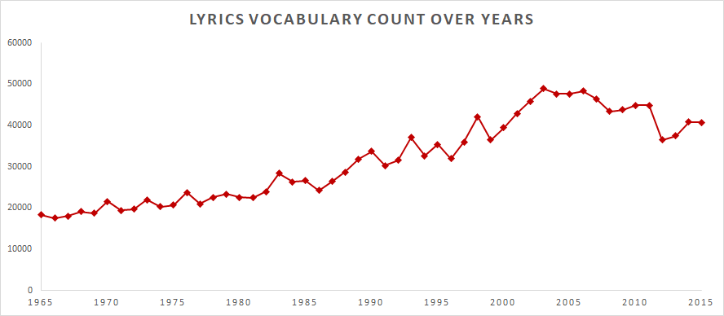

Slide 17
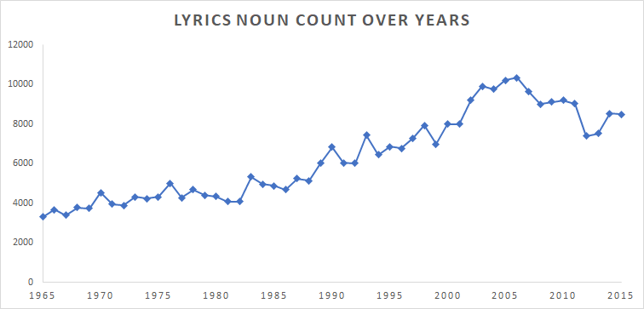

Slide 18
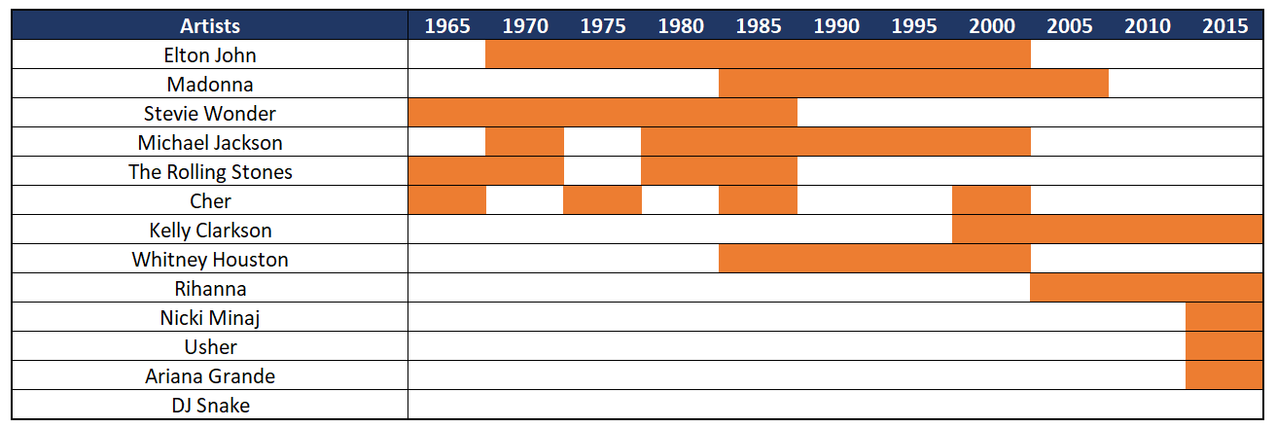
Years Artists were active on Billboard top 100's list

